Slide 1
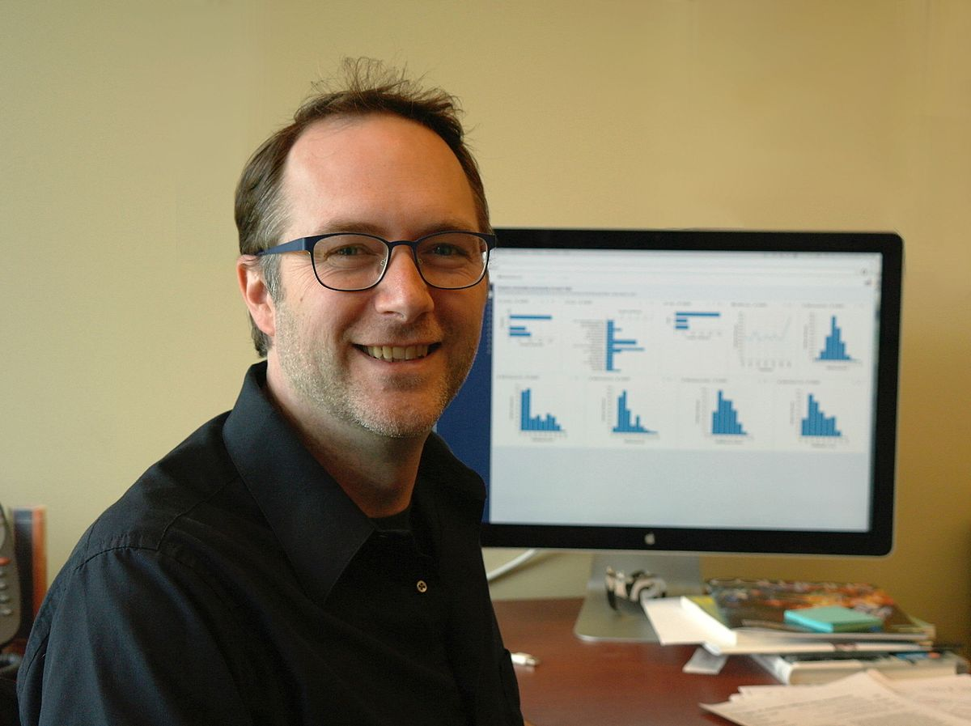

Narrative Visualization
Edward Segel
Michael Tran
Jeffrey Heer

Slide 2
Paper recap
Storytelling definition
Visual storytelling and its origins and uses
Storytelling with Data Visualizations
Data Visualization case studies
Notes:
Using data to drive a narrative and the methods of doing so
Paper distinguishes the different methods of visualizations and categorizes them
They’ll then use the categories to form the foundations of design strategies-- it’s not all completely new, they build upon other mediums of storytelling(news, comics, slideshows)

Slide 3
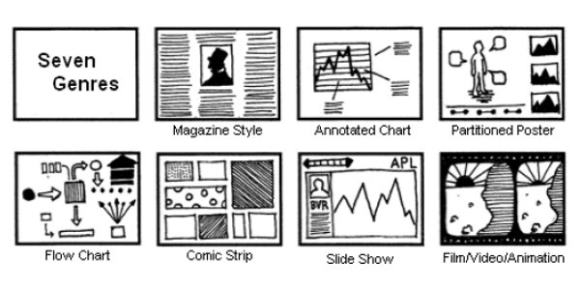
Design Space Dimensions
Genre
Visual Narrative Tactics
Visual Narrative Tactics
i.Visual Structuring
i.Ordering
ii.Highlighting
ii.Interactivity
iii.Transition Guidance
iii.Messaging

Slide 4

Author Driven
Reader
Driven
Notes:
There is no right answer to how a visualization should be modeled. Each is context driven and you would need to find the best methods to convey your idea.

Slide 5

Pros and Cons
Notes:
Pros- Good job of conveying the information(defined to orient the reader, delved deeper into the topic, and then gave examples), presented novel ideas(such as the author/reader spectrum and design space dimensions), created their own visualization for their data as well as creating media such as the “seven genres”
Cons- Some of the visualizations included some type of movement(transitions, interactive timelines, details-on-demand) had to go search the visualizations up to somewhat follow at points. Actually don’t like their visualization because at first glance, it’s a lot to take in. Only after reading the annotation at the bottom did things make sense.
How could the paper be improved? -- Better visualization for their samples “typically, data is not presented all at once”. How did they qualify those data visualizations for their study? A lot of them are from the same source..

Slide 6
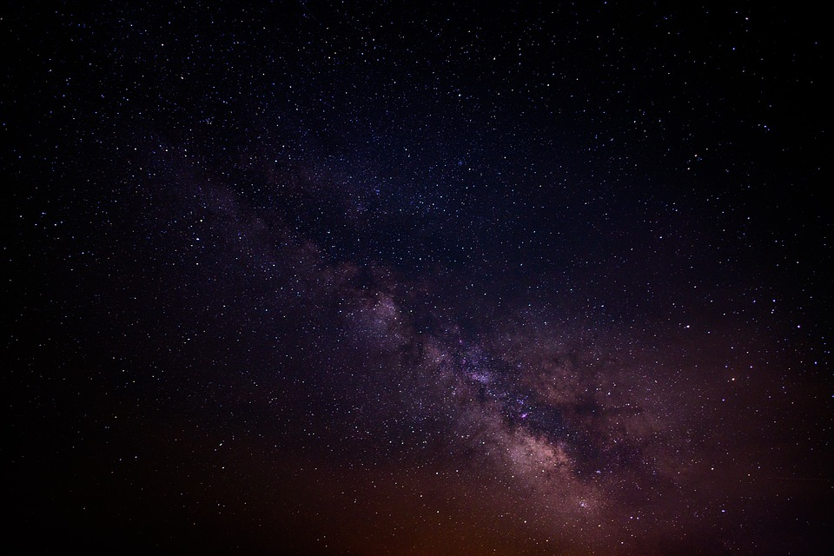
What were your favorite aspects of this paper?
Were the authors able convey their message in a concise way that wasn’t confusing?
Did you have any questions that were unanswered?
Notes:
Signifies the authors’ notion that this field is still developing and that their work, no matter how intensive it is, is limited by their disclaimer of not being expects in the study of narrative. They pose many questions and leave some remarks on the trajectory of where this research is headed.

